Slide 1
Design and Implementation of Database Support in nDiskFS
M.Tech Project defence by
Nuka Siva Kumar

Slide 2

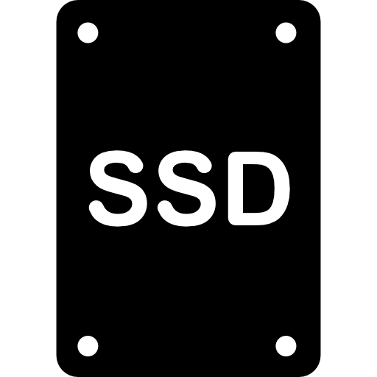
Filesystems in the Linux Kernel
Application processes
System calls
Linux kernel support multiple Filesystems.
VFS layer acts as a generic interface between the user space and the Filesystems.
VFS layer
FS1
FS2

Slide 3
nDiskFS: A hybrid storage file system
Applications in userspace
nDiskFS is a Filesystem under development.
Design Moto: support for hybrid storage.
Current features: FS managed page cache, migration at file and block granularity.
Kernel
VFS layer
nDiskFS

Slide 4
nDiskFS: Current state
Applications in userspace
Current nDiskFS support
File system creation (mkfs), mount and unmount
Basic file system calls: open, read, write, lseek etc.
Directory operation system calls
nDiskFS is a Filesystem under development
Design Moto: support for hybrid storage
Current features: FS managed page cache, migration at file and block granularity
Kernel
VFS layer
nDiskFS

Slide 5
Project overview
Database Support
1
nDiskFS
Modular Resource Accounting
2
Pluggable Policy framework
3

Slide 6
Outline
Background
Design and Implementation
Evaluations
Conclusion

Slide 7
Working of Linux Pagecache
Linux pagecache caches the disk blocks in memory pages
Modified pages synced to the underlying disks asynchronously
Kernel
Filesystem
Page
Read/ Write
Process

Slide 8
Working of Linux Pagecache
Linux pagecache caches the disk blocks in memory pages
Modified pages synced to the underlying disks asynchronously
Kernel
Page
Filesystem
Page
Read/ Write
Process
Block I/O

Slide 9
Working of Linux Pagecache
Linux pagecache caches the disk blocks in memory pages
Modified pages synced to the underlying disks asynchronously
Kernel
Page
Filesystem
Page
Read/ Write
Process
Block I/O

Slide 10
Caching pages in nDiskFS
nDiskFS bypasses the Linux pagecache and maintains its own pagecache.
All the reads and writes directly go the nDisFS.
Kernel
nDiskFS
Page
Page
Application
process
Read/ Write
Block I/O

Slide 11
MMap in Linux Kernel
Kernel
Page
Filesystem
Application
process
Mmap
vm_area_struct
VM_READ | VM_EXEC | VM_WRITE
vm_operations
File
Mmap maps the file into process address space.
Mmap vm_opeerations handles page faults and transfers dirty pages information to Linux pagecache.
Notes:
Move the figure to the top

Slide 12
MMap in Linux Kernel
Kernel
Page
Filesystem
Application
process
Mmap
vm_area_struct
VM_READ | VM_EXEC | VM_WRITE
vm_operations
File
Mmap maps the file into process address space.
Mmap vm_opeerations handles page faults and transfers dirty pages information to Linux pagecache.
Notes:
Move the figure to the top

Slide 13
MMap in Linux Kernel
Kernel
Page
Filesystem
Application
process
Mmap
vm_area_struct
VM_READ | VM_EXEC | VM_WRITE
vm_operations
File
Mmap maps the file into process address space.
Mmap vm_opeerations handles page faults and transfers dirty pages information to Linux pagecache.
Notes:
Move the figure to the top

Slide 14
File Synchronizations in Linux
Kernel
fsync,
fdatasync,
O_SYNC
O_DSYNC
Page
Filesystem
Application
process
Applications in the userspace force the Linux pagecache to syncs the file data with the on disk data.
Notes:
Move the figure to the top

Slide 15
File Synchronizations in Linux
Kernel
fsync,
fdatasync,
O_SYNC
O_DSYNC
Page
Filesystem
Application
process
Applications in the userspace force the Linux pagecache to syncs the file data with the on disk data.
Notes:
Move the figure to the top

Slide 16
Direct I/O in Linux
Direct I/O in Linux facilitates the applications to perform read/write directly to the disk.
Kernel
Page
Applicationprocess
Read/ Write
O_DIRECT
Filesystem
Notes:
Move the figure to the top

Slide 17
Lack of Modularity Accounting in nDiskFS
Scattered
usage of Memory API’s.
Lack of memory
usage accounting in nDiskFS.
Scattered
Accounting in nDiskFS subsystems.
Linux Kernel
Memory API’s
nDiskFS
block cache
page
cache
inode
cache
file,
directory operations
statistics
statistics
statistics
statistics

Slide 18
Lack of Pluggable Policy Framework
Pagecache
design tightly coupled with eviction policy.
Lack of pluggable
policy framework.
nDiskFS pagecache
LRU list of files
File 1
File 2
File 3
File 4
File 4
blk
blk
blk
blk
blk
blk
LRU list of blocks

Slide 19
Outline
Background
Design and Implementation
Evaluations
Conclusion

Slide 20
Functionalities Supports in nDiskFS
Applications in Userspace
Read/Write✔️ Create✔️
Open/Close✔️ Remove✔️
Lseek✔️ Pagecached I/O✔️
Mmap❌ Vectored Read/Write❌
File Syncs❌ Direct I/O❌
OS
nDiskFS

Slide 21
MMap in nDiskFS
ndfs_vm_ops handles
page faults and transfers dirty pages information to nDiskFS.
Kernel
nDiskFS
ndfs_vm_ops
Page
Pagecache
vm_area_struct
VM_READ | VM_EXEC | VM_WRITE
vm_operations
File
Application
process
Mmap

Slide 22
MMap in nDiskFS
ndfs_vm_ops handles
page faults and transfers dirty pages information to nDiskFS
Kernel
nDiskFS
ndfs_vm_ops
Page
Pagecache
vm_area_struct
VM_READ | VM_EXEC | VM_WRITE
vm_operations
File
Application
process
Mmap

Slide 23
Vectored Read/Write in nDiskFS
read_iter/write_iter
File
File
Read/Write
User buffer
User buffers
Readv / Writev system calls, vfs_iter_read , vfs_iter_write kernel exported functions uses Vectored read/writes.

Slide 24
nDiskFS Pagecache Extensions
nDiskFS
File Synchronizations
File Data sync
Page
File Metadata sync
Direct I/O
File data eviction
nDiskFS File Sychronizations, Direct I/O uses pagecache extensions to sync, evict file blocks.

Slide 25
File Synchronization in nDiskFS
nDiskFS syncs the File data, metadata to the persistent device and flushes diskcache.
Kernel
nDiskFS
fsync,
fdatasync,
O_SYNC
O_DSYNC
Page
Application
process
file_ops

Slide 26
Direct I/O in nDiskFS
Kernel
Added O_FSDIRECT flag
to the linux kernel 4.19.13.
nDiskFS
Page
Application
process
Read/Write
O_DIRECT
file_ops

Slide 27
Modular Resource Accounting
All the memory allocation requests go through the resource accounting module.
Central module for both memory usage and statistics.
Linux Kernel
nDiskFS
block cache
page
cache
Resource
accounting
support
inode
cache
Filesystem
operations

Slide 28
Pluggable Policy Framework
nDiskFS Pagecache
Policy 1
Access pattern policy
Access pattern policy interface
Resource
accounting
support
Policy 2
Policy 1
Eviction policy
Eviction policy
interface
Policy 2

Slide 29
Outline
Background
Design and Implementation
Evaluation
Conclusion

Slide 30
Experimental Setup
Virtual Machine
Tested nDiskFS
correctness with TPC-C
benchmark (with MySQL DB)
Demonstrate resource
accounting statistics
TPC-C
Kernel
nDiskFS
Ext4
Hypervisior
vda
vdb
vdc

Slide 31
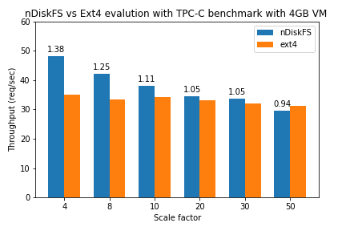
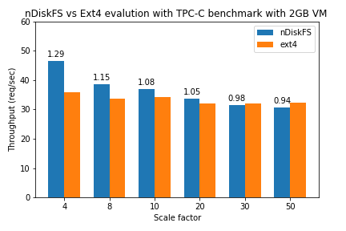
Correctness of the nDiskFS
Notes:
Figure on top

Slide 32
Correctness of the nDiskFS
Shows the correctness of the nDiskFS with various scale factors, different VM memory configurations.
Poor performance with memory pressure.

Slide 33
Application Forced File synchronizations Statistics
Operation Count | VM Memory size = 2GB | VM Memory size = 4GB
#fsync calls | 151467 | 145964
#data blocks synced | 12050667 | 12244537
#meta-data blocks synced | 6849 | 6209
#inodes synced | 1456964 | 1449898
#bitmap blocks synced | 1955 | 1959
#file blocks synced | 12057516 | 12250746

Slide 34
Application Forced File synchronizations Statistics
Operation Count | VM Memory size = 2GB | VM Memory size = 4GB
#fsync calls | 151467 | 145964
#data blocks synced | 12050667 | 12244537
#meta-data blocks synced | 6849 | 6209
#inodes synced | 1456964 | 1449898
#bitmap blocks synced | 1955 | 1959
#file blocks synced | 12057516 | 12250746
nDiskFS shows similar statistics invariant of the memory configuration.

Slide 35
Demonstrating resource accounting
Number of allocations in nDiskFS
# pages 125895 ~ 491MB
# <32B allocations 126197
# <64B allocations 126196
# >64B allocations 126527
Memory usage in Bytes for internal structures
view_cache_page_used 13093080
view_cache_block_used 12085920
view_inode_cache_used 266976
view_kmalloc_size_used 15319656

Slide 36
Outline
Background
Design and Implementation
Evaluations
Conclusion

Slide 37
Conclusion
This project enables the database support in nDiskFS.
Added modularity in accounting memory usage, filesystem statistics.
Added pluggable policy framework for block placement, pagecache management policies.
Tested the correctness of the nDiskFS with MySQL DB on Linux.
Pluggable policy framework is not tested yet/

Slide 38
Future Work
Proper block placement policies, eviction policies need to be designed in nDiskFS.
Make nDiskFS to be fully POSIX standard compliant.
Proper file system consistency support needed in nDiskFS.

Slide 39
Acknowledgements
I Wish to acknowledge Dr. Debadatta Mishra for his dedicated support and motivating me in the right direction.
I wish to acknowledge Mr. S V Shanmuga Sundar, Mr. Pallav Agarwal for their contributions to the nDiskFS.
Notes:
Move this slide to the end

Slide 40
References
S V shunmuga Sundar, (2019). nDiskFS: A Filesystem for hybrid storage. In IITKanpur, M.Tech Thesis.
Operating Systems: Three Easy Pieces. In ArpaciDusseau18-Book.
https://lwn.net/Articles
Kernel Version 4.19.13

Slide 41
Thank You

